Slide 1
Use of MPLab software
Paul Cockshott

Slide 2
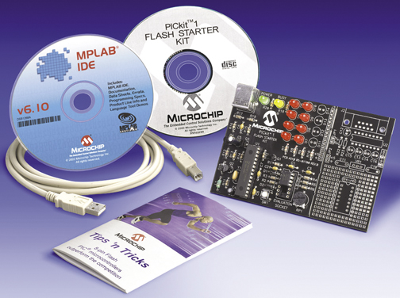
PIC KIT

Slide 3
Get the kit
Kits are locked in cupboard
Get from lab supervisor
Plug into the usb port on your computer

Slide 4
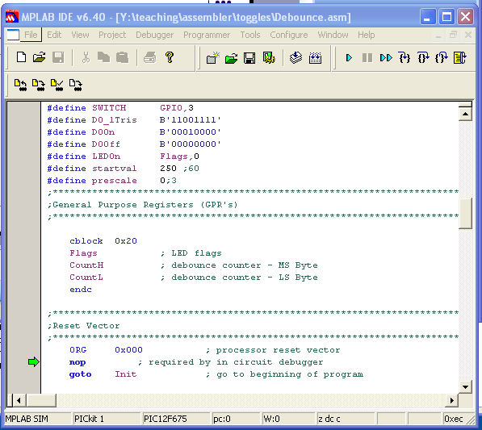
MPLAB

Slide 5
How to use
create a project
enter program
assemble program
down load program
run program
simulate

Slide 6
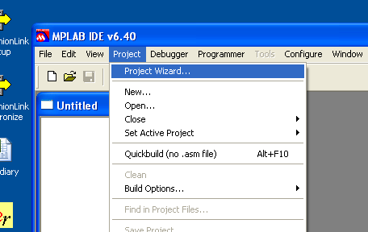
New project

Slide 7
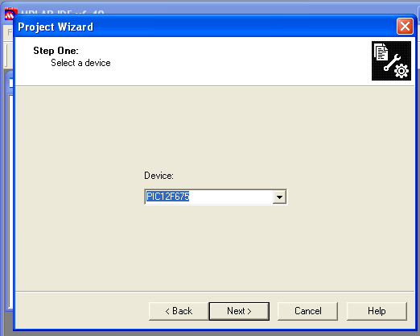

Select chip type PIC12f675

Slide 8
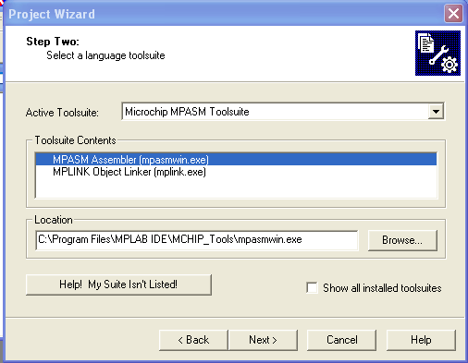
Select tool
you should select
the assembler tools
(We do not provide basic)

Slide 9
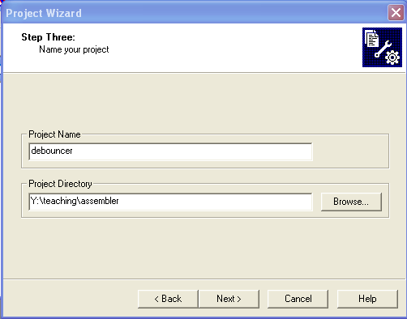
Name your project

Slide 10
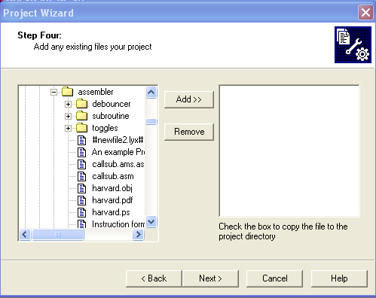
Skip adding files

Slide 11
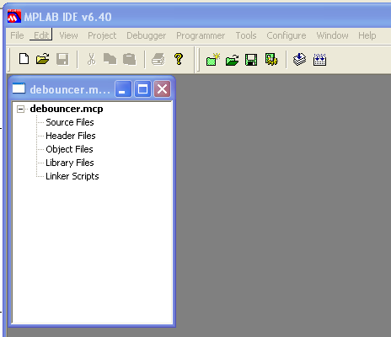
Resulting project file
Now click on File->New to get a new blank file
Type in your program.
For the example copy this from the web page.
It may be quicker to cut and paste.

Slide 12
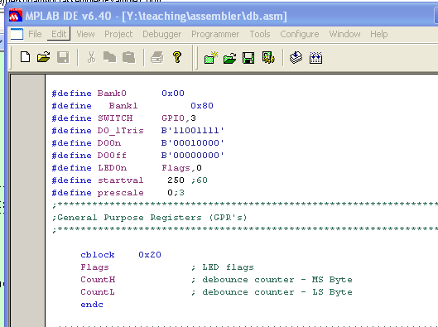
Save file
Once you have entered your program save it with the extension .asm
At this point the syntax highlighting will switch on.

Slide 13
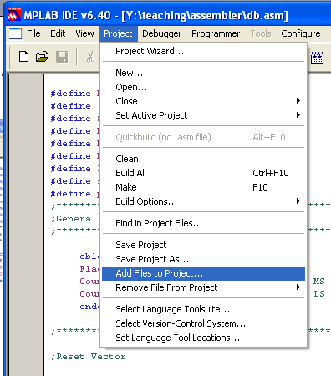
Add to project
Once the file is saved you can add it to your project

Slide 14
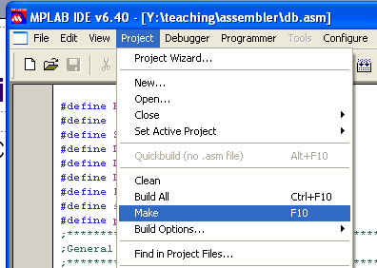
Run the assembler
Goto the project menu
Select Make

Slide 15
Success!
If it works you will get a message like those opposite
Executing: "C:\Program Files\MPLAB IDE\MCHIP_Tools\mpasmwin.exe" /q /p12F675 "db.asm" /l"db.lst" /e"db.err"
Message[302] Y:\TEACHING\ASSEMBLER\DB.ASM 113 : Register in operand not in bank 0. Ensure that bank bits are correct.
Message[302] Y:\TEACHING\ASSEMBLER\DB.ASM 117 : Register in operand not in bank 0. Ensure that bank bits are correct.
Message[302] Y:\TEACHING\ASSEMBLER\DB.ASM 119 : Register in operand not in bank 0. Ensure that bank bits are correct.
Warning[207] Y:\TEACHING\ASSEMBLER\DB.ASM 225 : Found label after column 1. (inittim)
Loaded Y:\teaching\assembler\db.COD
BUILD SUCCEEDED: Tue Sep 21 14:36:41 2004

Slide 16
Correct errors
If an error occurs you will get a build fails message
If you double click on the error message you will be taken to the line with the error so that you can correct it
Error[113] Y:\TEACHING\ASSEMBLER\DB.ASM 117 : Symbol not previously defined (TRISIO9)
Message[302] Y:\TEACHING\ASSEMBLER\DB.ASM 119 : Register in operand not in bank 0. Ensure that bank bits are correct.
Warning[207] Y:\TEACHING\ASSEMBLER\DB.ASM 225 : Found label after column 1. (inittim)
Halting build on first failure as requested.
BUILD FAILED: Tue Sep 21 14:40:30 2004

Slide 17
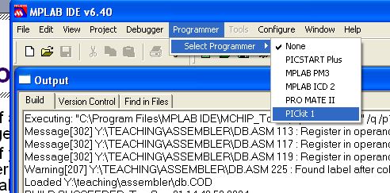
Select PICkit 1 programmer

Slide 18
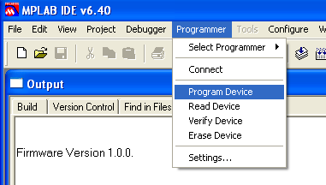
Program the chip

Slide 19
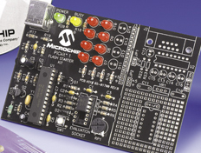
Test on board
Pressing the button should cause one of the LEDs to go on or off.

Slide 20
Simulator
If you go to the debug menu, and select the simulator tool then you can simulate the running of your program using an emulator.
This enables you to single step through your program

Slide 21
Simulator toolbar
reset
step out of routine
step over routine
step into
animate
run

Slide 22
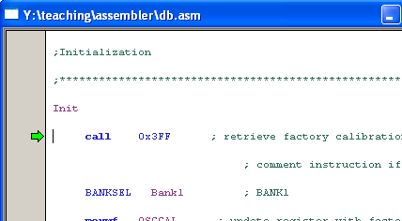
Running in emulation mode
The current line being executed is indicated by an arrow in the source window

